Slide 1
SWARM ROBOTS
By Ramic Muhamed (1915869)

Slide 2
01
02
INTRODUCTION
BACKGROUND
03
04
Types
COMPONENTS
What are swarm robots?
Where did they come from?
What varieties currently exist?
What is their structure?

Slide 3
05
07
FUTURE SIGHT
NAVIGATION SYSTEM
06
08
APPLICATIONS
conclusion
What are the possibilities?
Where are they used?

Slide 4

1. INTRODUCTION

Slide 5
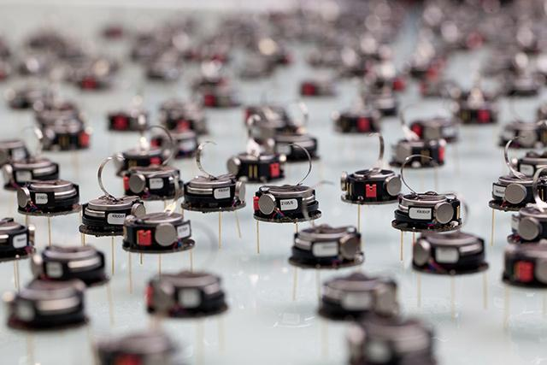
BASICS OF SWARM ROBOTS
Swarming robots are a type of robotic system that consists of multiple small robots working together to achieve a common goal. These robots can communicate with each other and coordinate their actions to accomplish complex tasks in a more efficient and effective way than a single robot could.
The concept of swarming robots is inspired by the behavior of social insects, such as ants and bees, which work together in large groups to complete tasks like foraging and nest building. Swarming robots have the potential to revolutionize many industries, from agriculture to manufacturing to search and rescue operations.

Slide 6
2. BACKGROUND

Slide 7
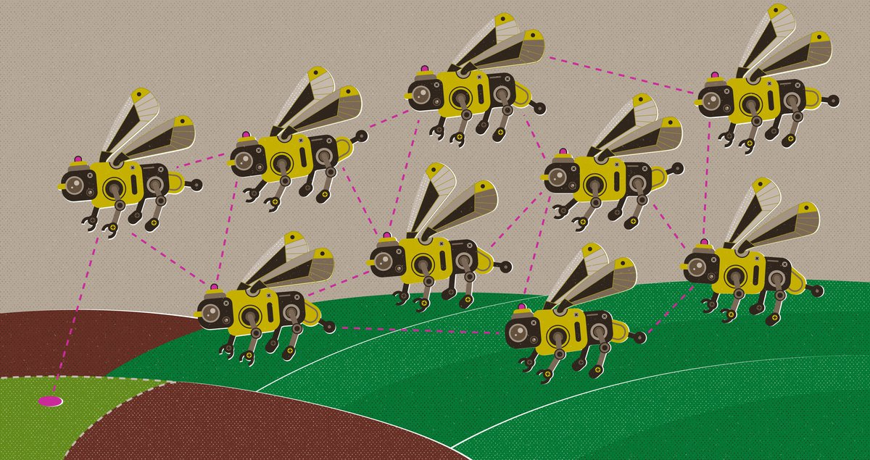
BACKGROUND
The idea of swarming robots has been around for decades, the first concept were known as the "Cogbots“, they were a class of robots that were created to resemble the behaviour of insects. Each robot carried out a distinct activity while interacting with its neighbours to accomplish a shared objective.
However, it wasn't until the early 2000s that the technology began to catch up with the concept. In 2002, researchers at the University of Southern California developed a swarm of small robots that could work together to move objects much larger than themselves.
Since then, swarming robots have been used in a variety of
applications, including environmental monitoring, surveillance,
and even art installations. As the technology continues to improve, the possibilities for swarming robots are endless.

Slide 8
3. Types

Slide 9
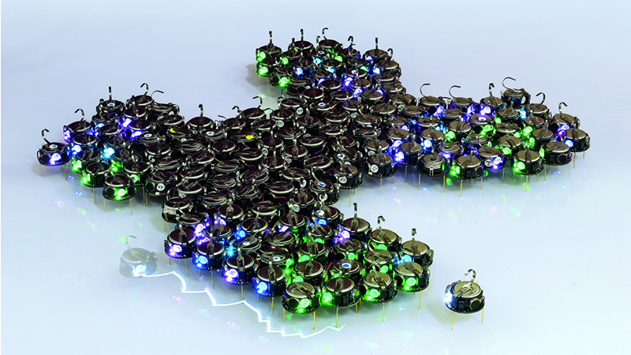
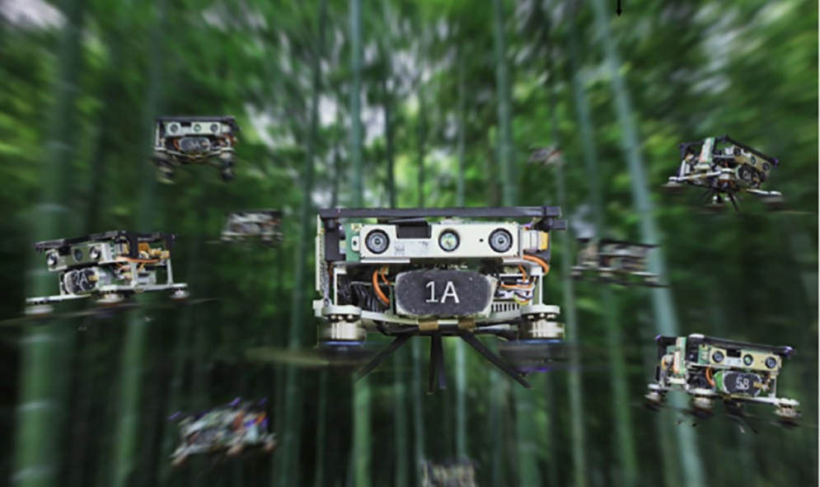
TYPES OF SWARM ROBOTS
There are several different types of swarming robots, each with its own unique capabilities and design features. One common type is the kilobot, a small, low-cost robot designed for research purposes. Kilobots can communicate with each other wirelessly and work together to perform simple tasks like moving objects and forming patterns.
Another type of swarming robot is the quadcopter, a small flying drone that can be programmed to fly in formation with other drones. Quadcopters are often used for aerial surveillance and mapping, and can also be used to transport small objects over short distances.

Slide 10
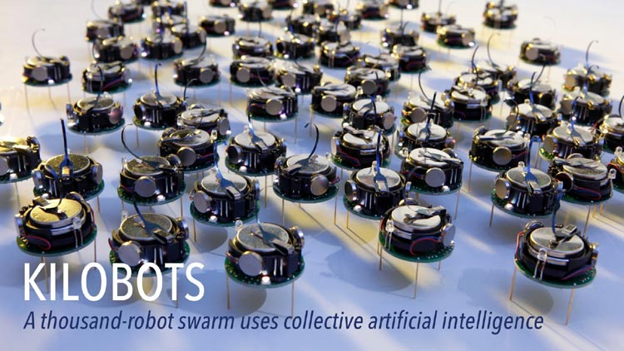
KILOBOTS
The name "Kilobot" derives from their small size and the goal of creating a system with a large number of robots. These tiny robots measure around 3.8 centimeters in diameter and are equipped with vibrating motors for locomotion. They also feature infrared transmitters and receivers, enabling them to communicate with each other and coordinate their actions.
One of the primary objectives of the Kilobot project was to create a scalable system that could operate with hundreds or even thousands of robots at once. By keeping the robots simple and inexpensive, researchers aimed to make swarm robotics more accessible and enable large-scale experiments.
Kilobots utilize a decentralized approach to coordination, which means that there is no central controller or leader robot. Instead, they rely on local interactions and the exchange of information through infrared communication. Each Kilobot is programmed with a set of basic rules, and by following these rules and interacting with neighboring robots, they can collectively perform complex behaviors.
The open-source nature of the Kilobot project has fostered collaboration and further advancements in the field. The availability of the robot's hardware design, software framework, and programming tools has allowed researchers from diverse backgrounds to contribute to swarm robotics research and develop new algorithms and applications.
The Kilobots have played a crucial role in advancing the field of swarm robotics by providing a scalable platform for studying collective behaviors and developing new algorithms. They have served as an inspiration for subsequent swarm robot designs and have helped to establish swarm robotics as a prominent research area, paving the way for the exploration of collective intelligence in robotic systems.

Slide 11
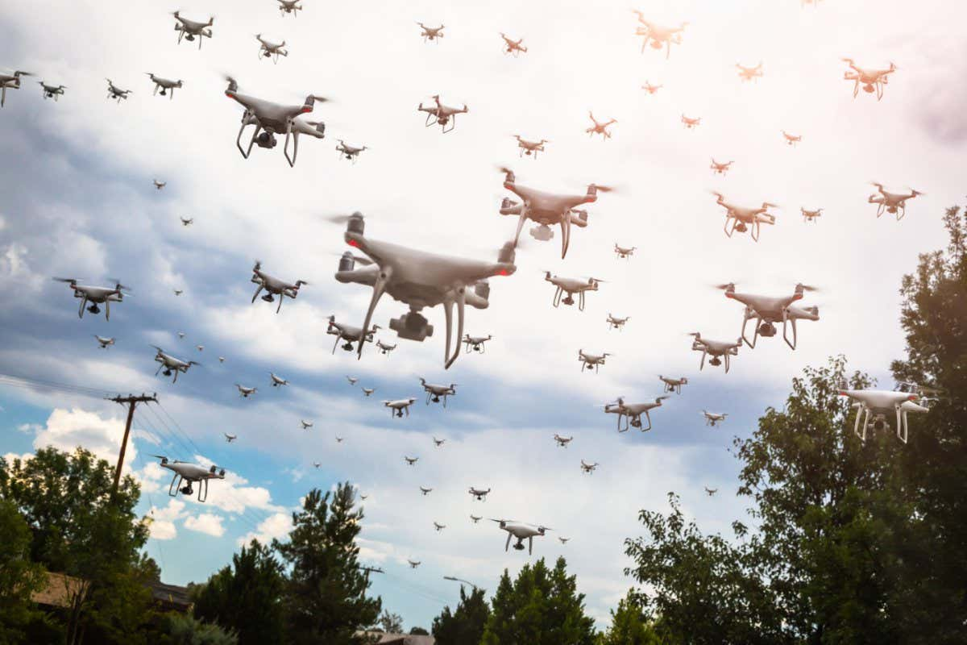
QUADCOPTERS
Quadcopter swarm robots, also known as quadrotor swarms or drone swarms, refer to a collection of unmanned aerial vehicles (UAVs) that work together in a coordinated manner to accomplish tasks. These swarms of quadcopters have garnered significant attention in recent years due to their versatility, agility, and potential for various applications.
Each quadcopter in the swarm is an individual autonomous vehicle capable of vertical takeoff, hovering, and agile maneuvering in the air. Quadcopters typically consist of four rotors arranged in a cross-like configuration, allowing them to generate lift and control their movement through adjustments in rotor speeds.
Quadcopter swarm robots have immense potential for future applications and research. Ongoing developments focus on enhancing swarm coordination, robustness, scalability, and autonomy.
With advancements in communication, sensing, and control technologies, quadcopter swarms are expected to play an increasingly significant role in various domains, ranging from aerial transportation and logistics to disaster response and surveillance.

Slide 12

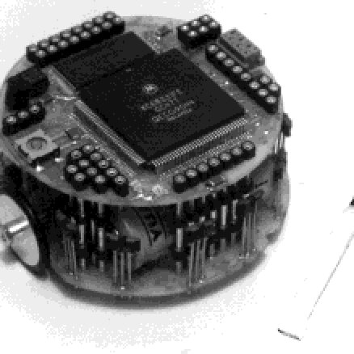
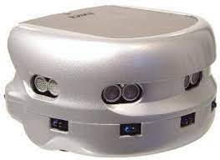
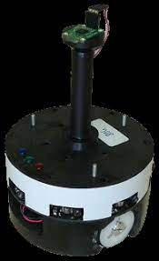
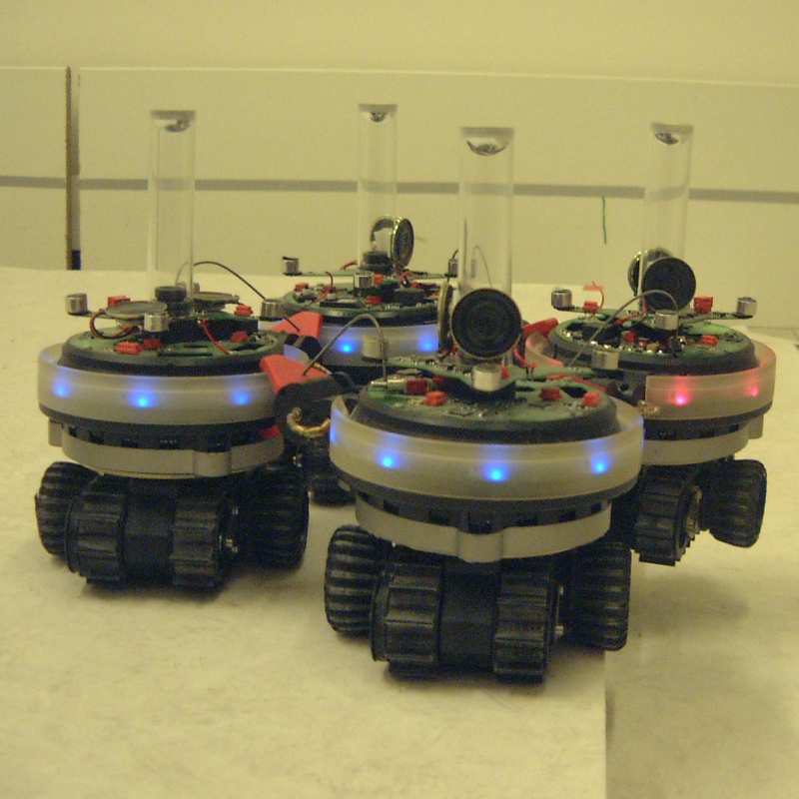
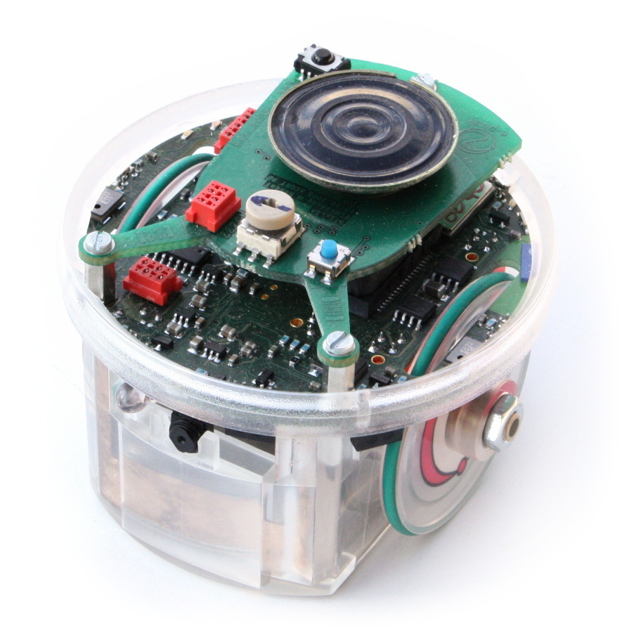
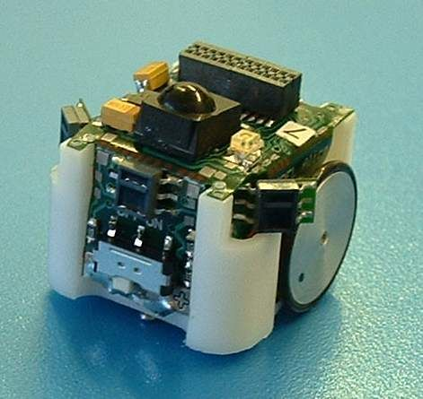
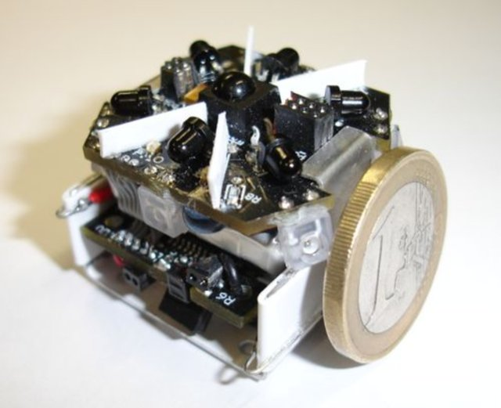
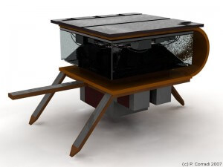
EXAMPLES OF EXISTING MODELS OF SWARM ROBOTS
Khepera
Khepera III
S-Bot
Kobot
E-puck
Alice
Jasmine
I-swarm robot

Slide 13
4. COMPONENTS

Slide 14
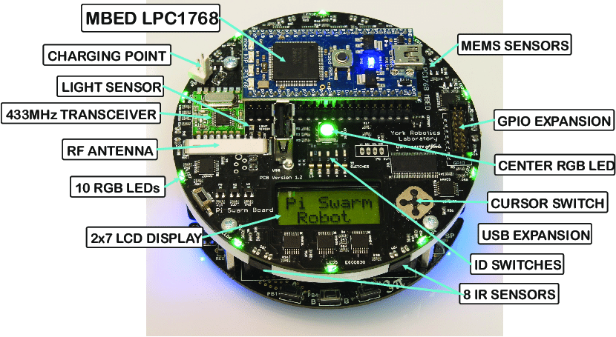
STRUCTURE EXAMPLE
Swarm robots typically consist of several key components that enable their autonomous operation and coordination within a group. While specific designs may vary, fundamental components commonly found in swarm robots are:
Processing Unit: A swarm robot is equipped with a central processing unit (CPU) or microcontroller that serves as its brain. The processing unit executes the robot's control algorithms, manages sensor data, and coordinates its actions within the swarm.
Sensors: Swarm robots are equipped with various sensors to perceive the environment and gather information. Common sensors include cameras, infrared sensors, ultrasonic sensors, proximity sensors, or environmental sensors like temperature or humidity sensors. These sensors enable the robot to collect data, detect objects or obstacles, and communicate with other robots in the swarm.
Actuators: Actuators allow the swarm robot to physically interact with the environment. They include motors, servos, or other mechanisms that enable locomotion, manipulation, or other physical actions.
Power Source: Swarm robots require a power source to operate autonomously. This can be a rechargeable battery or, in some cases, energy harvesting mechanisms that allow the robot to harvest energy from the environment.
Communication Module: Communication is a crucial aspect of swarm robots. They require a communication module to exchange information and coordinate their actions. Wireless communication technologies like Wi-Fi, Bluetooth, or radio frequency modules enable swarm robots to share data and messages and to collaborate effectively within the swarm.
Chassis and Mechanical Structure: The physical structure of a swarm robot, often referred to as the chassis or frame, provides the foundation for attaching components and ensures the robot's structural integrity. The chassis may be designed to accommodate the robot's specific locomotion or manipulation capabilities, depending on the intended application.

Slide 15
5. NAVIGATION SYSTEM

Slide 16
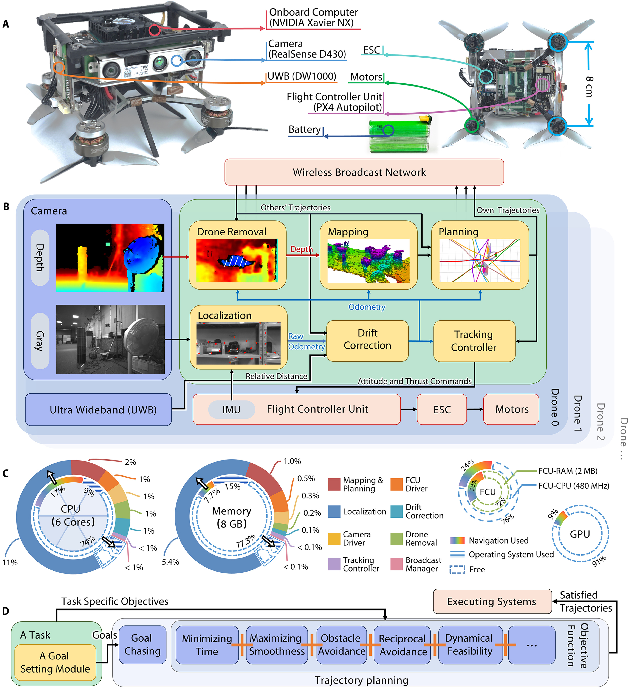
SWARM NAVIGATION
01
The navigation system of a swarm robot plays a vital role in enabling the robot to move and navigate autonomously within its environment. The navigation system allows the robot to determine its position, plan paths, avoid obstacles, and interact with other robots in the swarm. Here are some key components and techniques commonly used in swarm robot navigation:
Localization: Localization is the process of determining the robot's position within the environment. Swarm robots often use techniques like odometry, which estimates position based on changes in wheel rotations or motor movements. Additionally, they may employ localization methods such as landmark-based localization or simultaneous localization and mapping (SLAM), which use sensor data to create a map of the environment and estimate the robot's position relative to that map.
Path Planning: Path planning involves determining a trajectory or path for the robot to follow to reach a target location or complete a task. Various algorithms, such as A* (A-star), Dijkstra's algorithm, or potential field methods, can be used to generate optimal or near-optimal paths.
Obstacle Avoidance: Swarm robots need to navigate around obstacles to reach their destinations. They utilize sensor information, such as proximity sensors or cameras, to detect and identify obstacles in their path. Collision avoidance algorithms enable the robot to calculate safe paths or adjust their trajectories in real-time to avoid collisions with obstacles or other robots.
Communication and Coordination: Communication is crucial in swarm robot navigation to exchange information and coordinate movements within the swarm. Robots can share their positions, maps, or obstacle information with each other, allowing them to avoid congestion and collaborate effectively. This coordination helps ensure smooth navigation and efficient task completion.
Exploration and Mapping: Swarm robots can explore unknown or partially known environments.
They employ mapping techniques, such as occupancy grid mapping or feature-based mapping, to create representations of the environment. By exploring and updating the map, swarm robots can navigate more effectively, avoid previously detected obstacles, and share map information with other robots in the swarm.
Decision-Making and Control: The navigation system includes decision-making algorithms that help the robot make appropriate choices while navigating. These algorithms consider factors like goal prioritization, obstacle proximity, energy efficiency, or task requirements to determine the robot's actions and control its movements.

Slide 17
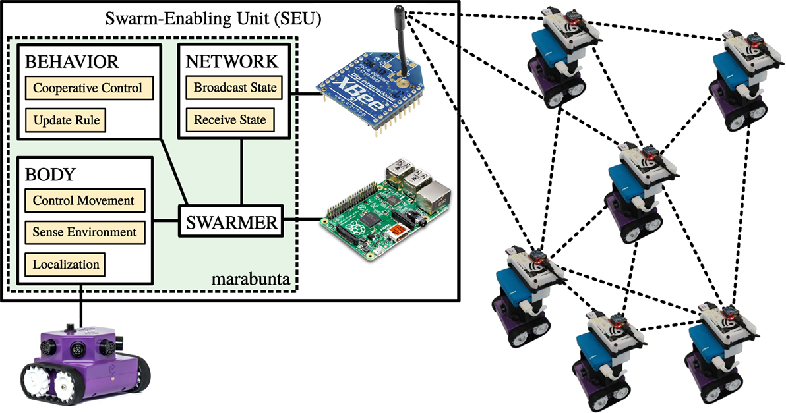
02
SWARM ENABLING UNIT
Swarm Communication: The swarm enabling unit includes communication capabilities that allow robots within the swarm to exchange information, share data, and coordinate their actions. This unit typically incorporates wireless communication protocols, such as Wi-Fi, Bluetooth, or RF modules, enabling robots to establish communication links and form a network within the swarm. Through this communication, robots can share their states, positions, sensor data, and other relevant information to collectively make decisions and coordinate their behaviors.
Swarm Coordination Algorithms: The swarm enabling unit may house specialized algorithms or protocols designed to facilitate coordination and collaboration among swarm robots. These algorithms determine how robots interact, cooperate, and distribute tasks within the swarm. They can encompass aspects such as task allocation, role assignment, formation control, or behavior synchronization. By employing these algorithms, the swarm enabling unit enables the swarm robots to work together efficiently and achieve complex tasks collectively.
Group Behavior Control: The swarm enabling unit may also include mechanisms for controlling the overall behavior of the swarm. It can enforce high-level directives, goals, or constraints onto individual robots, ensuring that the collective behavior of the swarm aligns with the desired objectives. This unit may incorporate algorithms that regulate the behavior of individual robots based on feedback from the swarm or external sources, allowing for adaptive and goal-oriented swarm behaviors.
Swarm Intelligence Integration: The swarm enabling unit plays a crucial role in integrating swarm intelligence principles into the collective behavior of the robots. It enables the aggregation of knowledge, decision-making processes, and emergent behaviors that arise from the interactions and cooperation among swarm members. By integrating swarm intelligence, the swarm enabling unit enhances the overall capabilities and adaptability of the swarm, allowing it to solve complex problems, exhibit robustness, and adapt to changing environments.

Slide 18
6. APPLICATIONS

Slide 19
APPLICATIONS
Search and Rescue: Swarm robots can be deployed in disaster scenarios to search for survivors in hard-to-reach or hazardous areas. They can cover large areas efficiently, communicate with each other to share information, and collaboratively locate and assist trapped individuals.
Environmental Monitoring: Swarm robots are used for monitoring and data collection in environmental studies. They can disperse across a region, gather data on parameters like temperature, humidity, air quality, or water quality, and transmit the information back to a central system for analysis.
Construction and Infrastructure Maintenance: Swarm robots can work together to perform construction tasks, such as assembling structures or repairing infrastructure. By coordinating their actions, they can efficiently complete complex tasks while adapting to changing conditions.
Precision Agriculture: In agriculture, swarm robots can assist in tasks like crop monitoring, pollination, or pesticide application. By working collectively, they can cover large fields, gather data on crop health, optimize resource utilization, and improve overall farm productivity.
Surveillance and Security: Swarm robots can be employed for surveillance purposes, enhancing security in various environments. They can monitor areas, detect intrusions, track objects, and communicate information to a central system or human operators.
Traffic Management: Swarm robots can aid in traffic management by collecting real-time data on road conditions, congestion, or accidents. By analyzing this data, traffic patterns can be optimized, and efficient routing and traffic control strategies can be implemented.
Swarm Robotics Research: Swarm robots serve as a valuable platform for researchers to study collective intelligence, emergent behaviors, and decentralized control algorithms. They provide insights into self-organization, coordination, and decision-making processes in large groups of robots, contributing to advancements in the field.

Slide 20
7. FUTURE SIGHT

Slide 21
$447,200,000
The swarm intelligence market is expected to be valued at
growing by 40.47% from 2020 to 2030

Slide 22
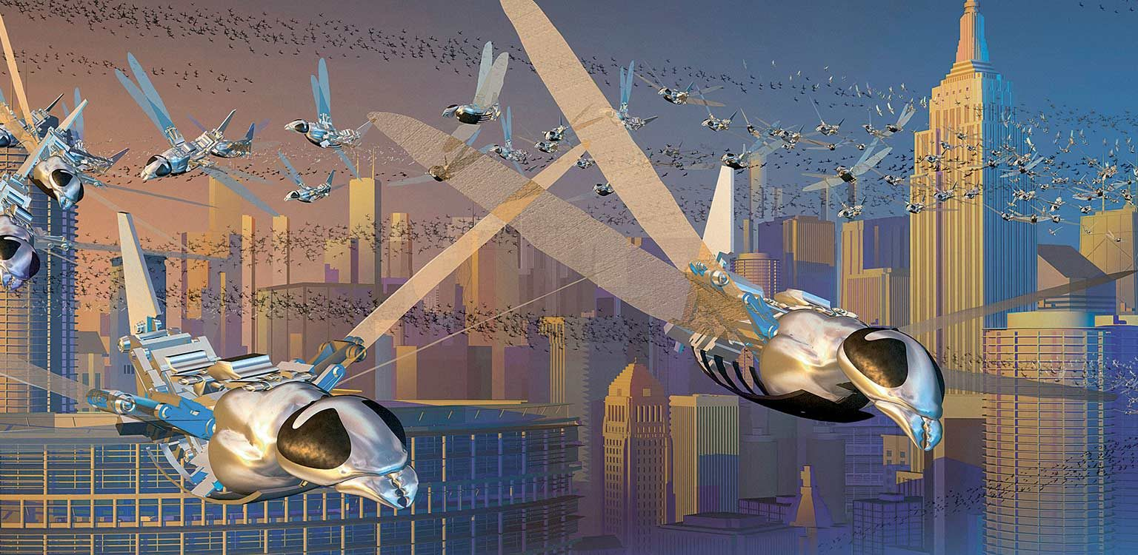
VISION OF SWARM ROBOTS
The future of robotic swarms is bright. As technology continues to advance, we can expect to see even more innovative uses for this technology. From space exploration to disaster response, the possibilities are endless.
Redundancy and Fault Tolerance: Swarm robots offer redundancy and fault tolerance due to their large numbers. If some robots in the swarm malfunction or are lost, the swarm as a whole can continue to operate and accomplish its tasks.
Scalability and Adaptability: Swarm robots can operate in large numbers, enabling them to tackle tasks on a larger scale. They can adapt their swarm size and configuration based on the requirements of a given task, making them highly flexible and adaptable to different scenarios.
Collective Intelligence: Swarm robots can leverage collective intelligence, where the combined knowledge and decision-making abilities of the entire swarm surpass those of individual robots. This enables them to solve complex problems, make collaborative decisions, and exhibit emergent behaviors that enhance their overall performance.
Adaptive Swarm Behaviors: Future swarm robots can possess advanced learning capabilities, enabling them to adapt and improve their behaviors over time. They can learn from their collective experiences, optimize their strategies, and acquire new skills. This adaptability allows swarm robots to tackle evolving challenges and dynamically adjust their approaches.
Human-Swarm Interaction: As swarm robots become more advanced, human-swarm interaction will play a crucial role. Humans can provide high-level goals and instructions to the swarm, and the robots can autonomously collaborate, execute tasks, and communicate relevant information back to humans. This collaboration between humans and swarm robots opens up possibilities for cooperative problem-solving and effective human-robot teaming.

Slide 23
8. CONCLUSION

Slide 24
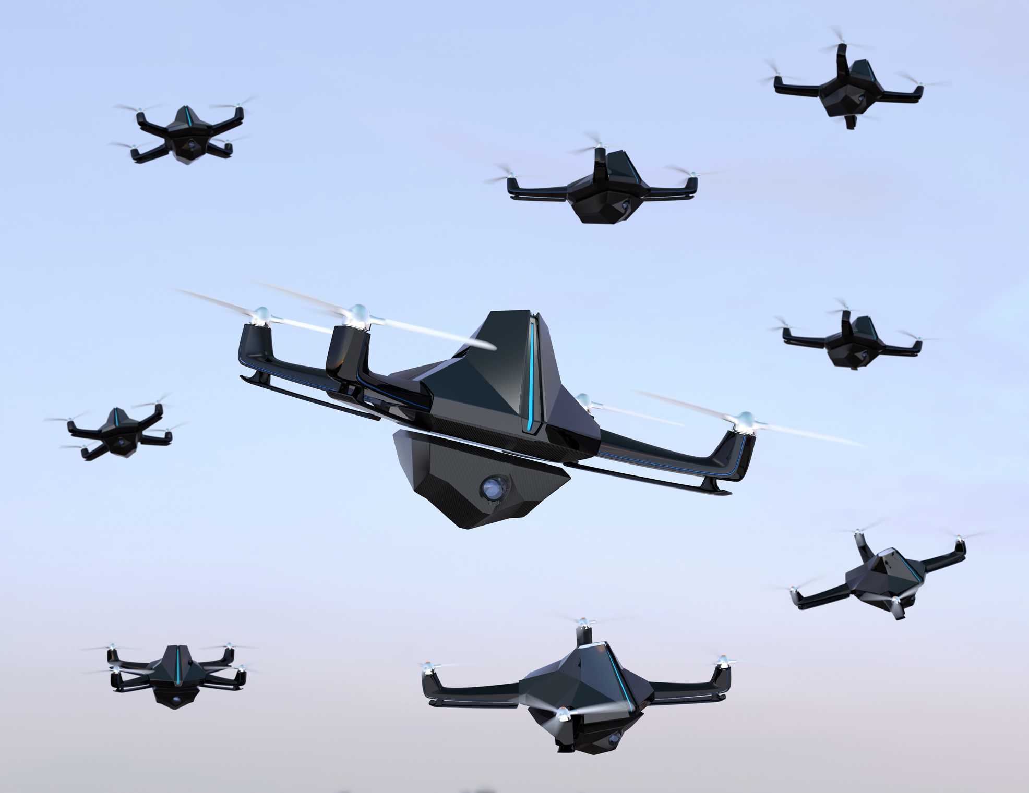
SWARM ROBOTS
The future of swarm robots holds exciting prospects across various fields, including disaster response, environmental monitoring, healthcare, agriculture, and industrial automation. With ongoing advancements in robotics, artificial intelligence, and communication technologies, swarm robots are poised to revolutionize industries, enhance productivity, and address complex challenges in a wide range of applications.

